Slide 1
High speed and adaptable error correction for megabit/s rate quantum key distribution
A. R. Dixon & H. Sato
Scientific Reports volume 4, Article number: 7275 (2014)
Pin-Yu Liao 5/25

Slide 2
Goal & Condition
Software post-processing
High-rate error correction
Maximize the secure key rate
Condition
Both CPU and GPU
bi-directional LDPC
Provide 90-94% of the ideal secure key
All fiber distance between 0-80 km

Slide 3
Procedure
Hardware : transmission and detection
Mbit/s
Software : post-processed
also able to operate at Mbit/s
DV-QKD
Sifting : high speed
Error correction : relatively computationally complex
Privacy amplification : easy but slow (big size matrix multiplication) →number theoretic transforms

Slide 4
How?
Minimizing the extra redundant information
Removed from secure key
Increase bit throughput rate
Upper limit
Reduce error correction failure rate
Discard data cannot be correct
→optimum combination of all three parameters

Slide 5
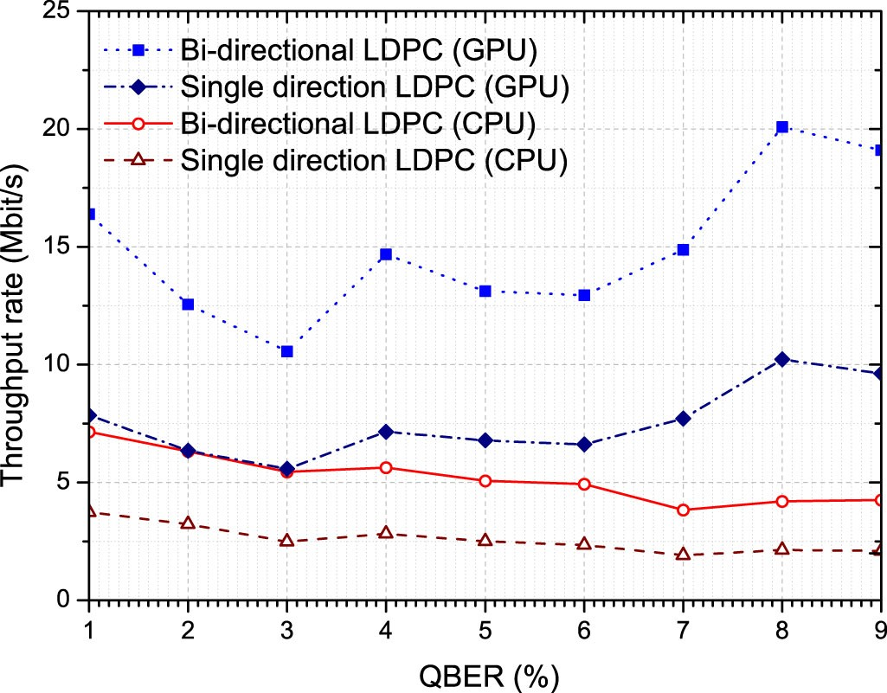
LDPC advantage
Offering different compromises between computational complexity (and so data throughput rates) and failure probability
Asymmetrical → single message in one direction
Encoder : easy (XOR)
Decoder : complex
→ Bi-directional

Slide 6
LDPC
Server PC (Intel X5675 3 GHz CPU, 3 GB RAM) and an additional graphical processing unit (NVidia M2090 GPU)
Sum-Product algorithm with log likelihood ratio (LLR) messages vs normalized Min-Sum
Can increasing the amount of additional information to reduce the number of iterations
Maximum number of iterations (typically between 50 and 100, set based on the failure rate

Slide 7
Some computer details
CPU : Serial message update scheduling
more effective (typically reducing the number of iterations by half)
GPU : flood scheduling
the memory access model of the GPU results in better performance with flood scheduling.
No difference : floating point or integer or shorter bit length
Use pre-built lookup tables on the CPU and native function calls on the GPU
Parallelized to run in multiple threads

Slide 8
LDPC
QBER = e
H(e) = -elog₂e-(1-e)log₂(1-e)
S = N(1–R)
S : size of the syndrome message
N : the size of the data to be error corrected
R : code rate ( between 0.55 and 0.85 )
R not fixed
p : control R, p = 0 → highest R

Slide 9
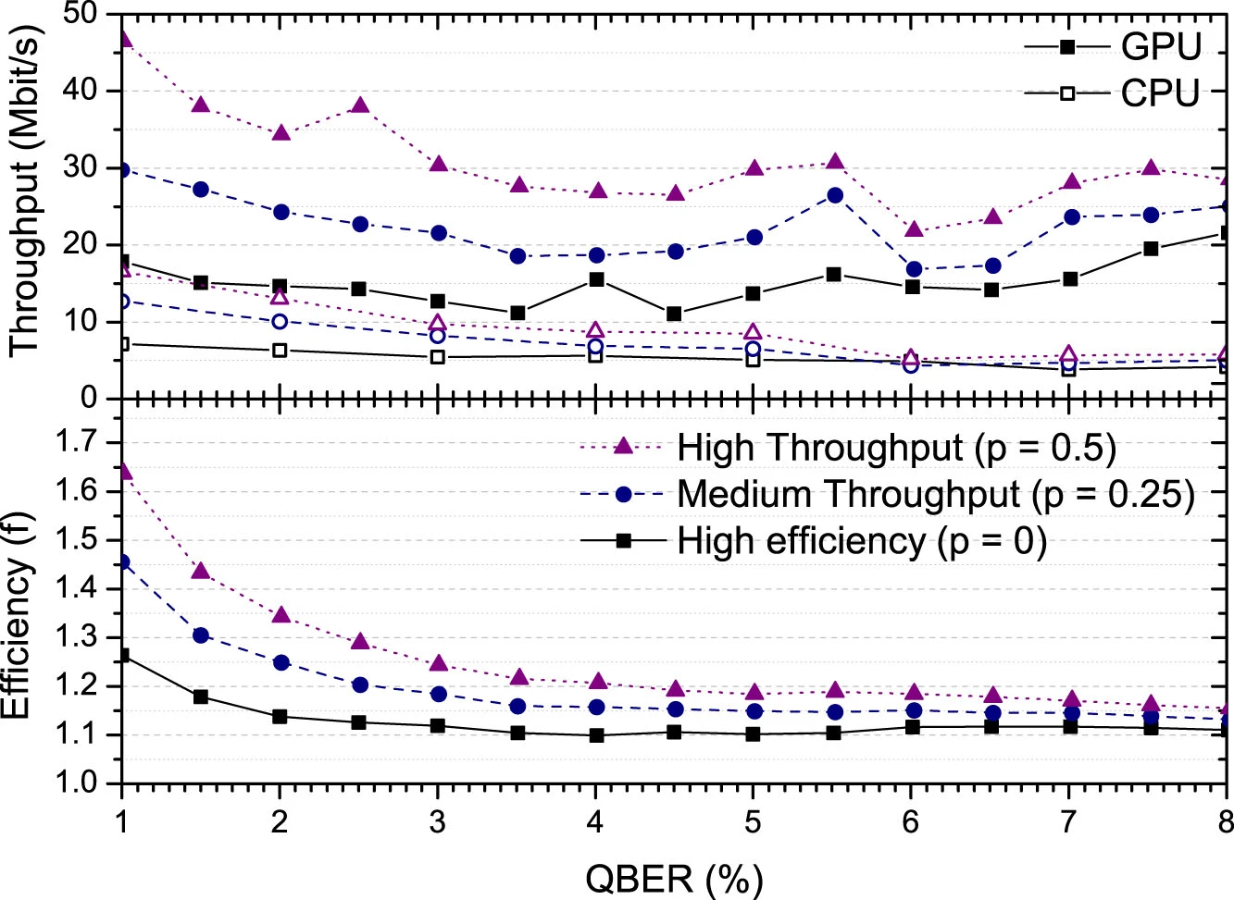
p
f : efficiency, fH(e) = information disclosed, f>1

Slide 10
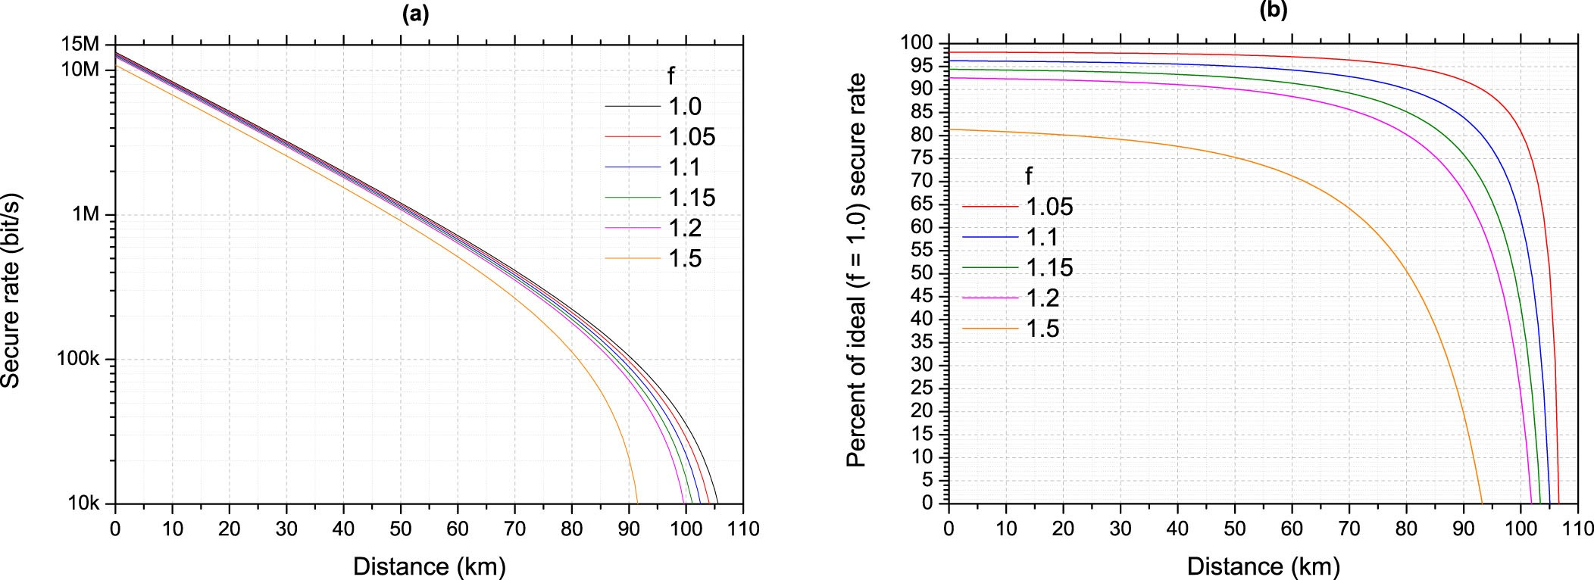
Distance
unlimited throughput
attenuation : 0.2 dB/km

Slide 11
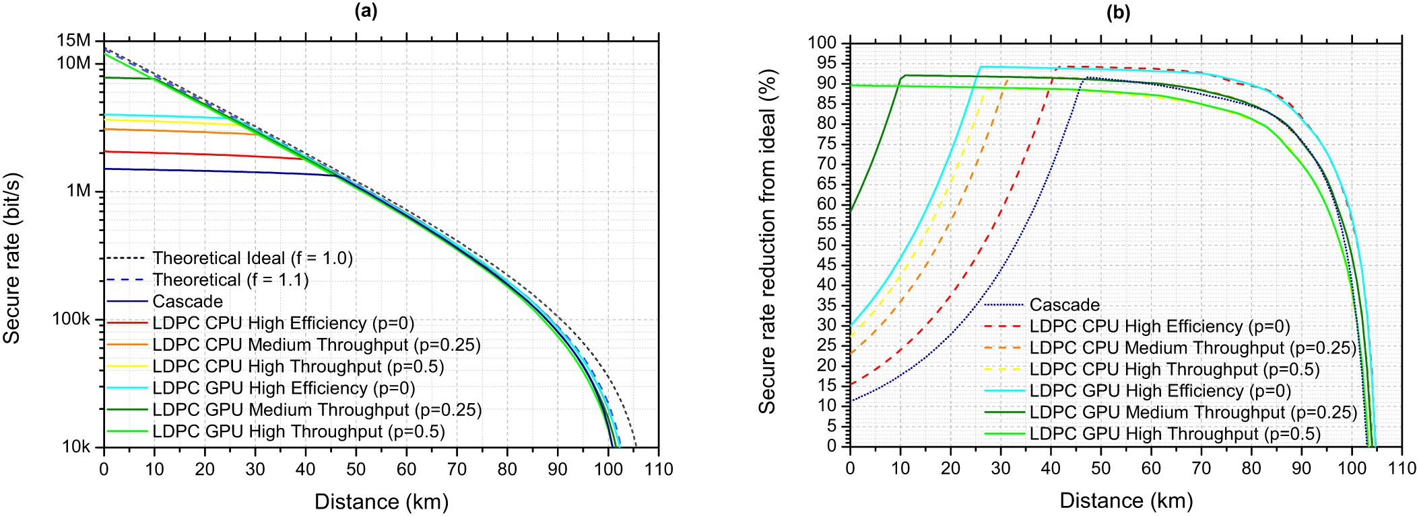
Vs cascade

